Slide 1
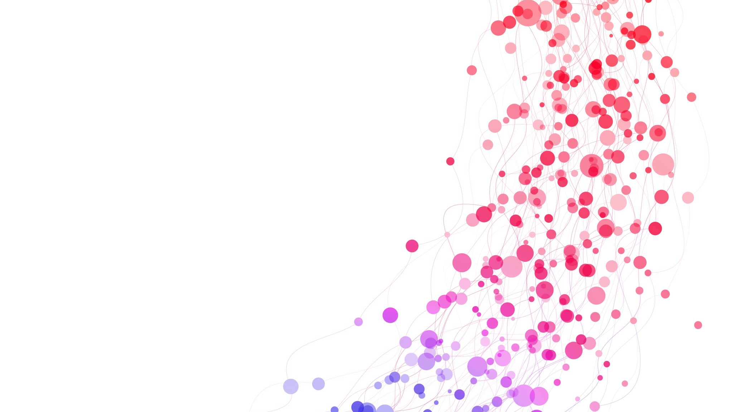
Transactions don’t exist
What to do if…

Slide 2
Where don’t transactions work?

